Slide 1

A presentation in honor of
ADHD Awareness Month
October 1 – 31, 2024

Slide 2


The debate is over
and
the truth about
ADHD is clear
Mainstream medical, psychological, and educational organizations have concluded that ADHD is a real, brain-based, medical disorder, and that children and adults benefit from appropriate treatment.
©ADHD Coaches Organization

Slide 3
10 myths about ADHD
ADHD doesn’t exist and is not a real disorder
People with ADHD just can’t concentrate
ADHD is over diagnosed
Only boys have ADHD
ADHD medications are addictive
ADHD is caused by bad parenting
ADHD is just an excuse for laziness
All children grow out of ADHD
Children with ADHD just need more discipline
Everyone has a little ADHD
https://www.adhdawarenessmonth.org/myths-and-facts-about-adhd/
Notes:
Source: http://www.help4adhd.org/en/about/myths
Article PDF: http://www.help4adhd.org/documents/June%202003%20ADHD%20Myths.pdf

Slide 4
WHAT is ADHD?
ADHD stands for Attention Deficit Hyperactivity Disorder
ADHD is a complex neurobiological condition
ADHD is highly hereditary
… what ADHD is not
ADHD is not a disease
ADHD is not a mental illness

Slide 5
There are 3 presentations of ADHD
Predominantly Inattentive Presentation
previously known as ADD, showing up as challenges with attention and concentration
Predominantly Hyperactive and Impulsive Presentation
showing up as challenges with hyperactivity and impulsivity
Combined Presentation
which involves challenges of inattentiveness, hyperactivity and impulsivity
Notes:
Previously it was called sub-types and it has now been revised to “presentations”

Slide 6


Conditions that often coexist with ADHD
Anxiety
Depression
Learning Disabilities
OCD (Obsessive Compulsive Disorder)
ODD (Oppositional Defiant Disorder)
CD (Conduct Disorder)
Dependency on or addictions to alcohol, drugs, gambling, shopping, food, etc.
Sleeping Disorders
Tics
Notes:
This is a list of conditions that many coaches recognize in their clients.

Slide 7
How prevalent is ADHD in the United States?
In the United States:
An estimated 7 million (11.4%) U.S. children aged 3-17 have ever been diagnosed with ADHD, according to a national survey of parents using data from 2022.*
ADHD diagnosis estimates among U.S. children aged 3-17 vary from 6% to 16% across states.*
The overall prevalence of current adult ADHD among U.S. adults is 4.4%.**
*from https://www.cdc.gov/adhd/data/index.html
**from https://www.nimh.nih.gov/health/statistics/attention-deficit-hyperactivity-disorder-adhd

Slide 8


How common is ADHD globally?
ADHD occurs throughout the
developed and developing world
5.9% of youths meet diagnostic criteria for ADHD*
Prevalence of ADHD in adulthood
is estimated to be 2.5%*
*Source: World Federation of ADHD International Consensus Statement (2021)
Notes:
The World Federation of ADHD International Consensus Statement - https://www.sciencedirect.com/science/article/pii/S014976342100049X?via%3Dihub
The percentages of diagnosed children and adults with ADHD may vary from one research to another. There is no definite numbers.
For more research: http://www.russellbarkley.org/factsheets/adhd-facts.pdf
Picture source: Microsoft ClipArt Online

Slide 9

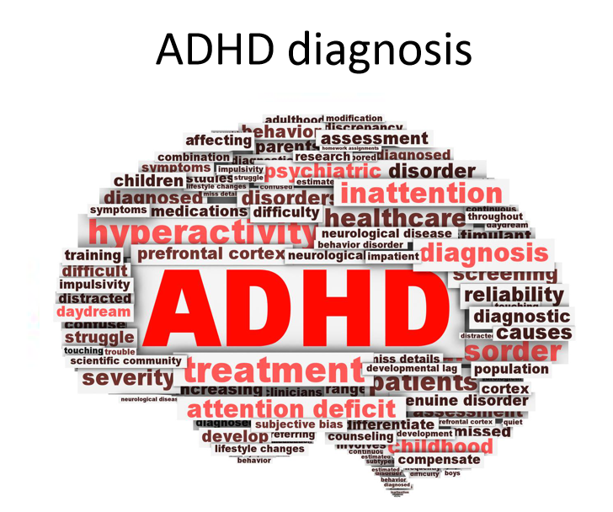
ADHD diagnosis

Slide 10

Where can I go to find out?
Physician
  Psychiatrist
  Pediatrician
  Neurologist
Psychologist
Nurse Practitioner or PA
Clinical Social Worker
Please note: Assessment and diagnosis might also be done by others not mentioned above and may vary from country to country
Notes:
http://www.additudemag.com/web/article/565.html

Slide 11

Clinical guidelines for diagnosis of ADHD
American Psychiatric Association’s Diagnostic and Statistical Manual of Mental Disorders
  Currently the DSM-5 (Fifth Edition). These established guidelines are widely used in research and clinical practice.
World Health Organization
  An alternative diagnostic criterion used in the diagnosis of ADHD is the ICD-11 Clinical description. It is very similar to the DSM-5.
This may vary from country to country.
Notes:
There might be other diagnostic tools that may vary from country to country
The International Classification of Diseases (ICD) is the standard diagnostic tool for epidemiology, health management and clinical purposes. This includes the analysis of the general health situation of population groups. It is used to monitor the incidence and prevalence of diseases and other health problems.
In DSM-IV, there were 3 ADHD subtypes:
http://sharpbrains.com/blog/2013/06/25/sensible-and-perplexing-changes-in-adhd-diagnostic-criteria-dsm-v/
Combined Type for individuals who showed at least 6 inat­ten­tive and 6 hyperactive-impulsive symptoms, in addi­tion to meeting all the other criteria;
Predominantly Inattentive Type when sufficient inattentive but insufficient hyperactive-impulsive symptoms were present; and,
Predominantly Hyperactive-Impulsive Type when sufficient hyperactive-impulsive symptoms inattentive but insufficient inattentive symptoms were present.
In DSM-V these categories have been retained, but are now referred to as Combined presentation, Predominantly inattentive presentation, and Predominantly hyperactive-impulsive presentation. I suspect this wording change reflects a desire to move from the more static language of ‘types’ to use terminology that better reflects the fluidity and change in how the disorder may present in the same individual over time.
More DSM-5 reading re ADHD:
From Dr. Thomas Brown
http://www.drthomasebrown.com/dsm-5-changes-in-adhd-diagnostic-criteria/
from ADDA
http://www.add.org/?page=DSM5

Slide 12

The importance of the clinical interview for diagnosing ADHD
Medical and developmental history
Family and individual psychiatric history
Family functioning and psychosocial stressors
Functional impairment
  Academic and behavioral performance at school
  Family relations and stress
  Completing routines and chores
  Social relationships
  Success in extracurricular activities
  Risk behaviors
  Mood regulation, frustration tolerance
Source: http://www.gmeded.com
Notes:
http://www.gmeded.com

Slide 13
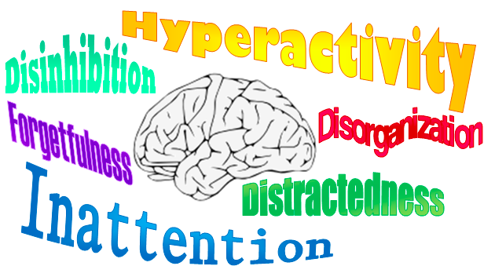
ADHD signs
Notes:
Picture from: http://www.insweb.com/news-features/adult-adhd.html

Slide 14

Where does ADHD show up?
For an ADHD diagnosis, symptoms need to be present in two or more settings (home, school, or work; with friends or relatives; in other activities)
©ADHD Coaches Organization
FRIENDS

Slide 15

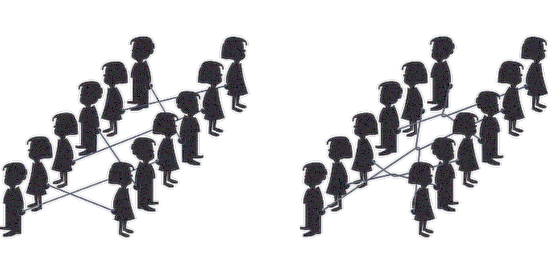
Where and how might ADHD show up in children?
School - missing or late assignments
Retaining and recalling information
Feelings of overwhelm
Interacting with peers
Transitions
Following instructions
Waiting for their turn
Notes:
Picture source: Pixabay

Slide 16

Where and how might ADHD show up in adults?
Employment issues - social and task related challenges
Financial troubles - impulsive spending or unpaid bills
Household - routines and organization
College - academics and homework
Marriage - conflict and distress
Social relationships
Notes:
Losing jobs; late for work; job performance, no promotions
Picture source: Microsoft ClipArt Online

Slide 17

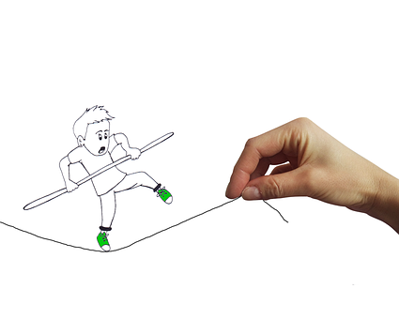
What gets in the way?
Without the conductor, an orchestra doesn’t perform well
Without good executive functioning, people with ADHD don’t perform well
Notes:
Think of it is an Orchestra. To make the orchestra perform well, it needs a conductor. If the conductor is not in control, the orchestra will perform poorly.
Likewise, with ADHD if one has trouble with the 6 Executive Functions, they can’t perform well either.

Slide 18
The 6 Executive Functions Model
Activation - Organizing, prioritizing and activating to work
Focus - Focusing, sustaining and shifting attention to tasks
Effort - Regulating alertness, sustaining effort and processing speed
Emotion - Managing frustration and modulating emotions
Memory - Utilizing working memory and accessing recall
Action - Monitoring and self-regulating action
by Dr. Thomas E. Brown
http://www.drthomasebrown.com/brown_model/index.html
Notes:
Taken from Thomas E. Brown's website: "Dr. Brown has developed an expanded model to describe the complex cognitive functions impaired in ADD Syndrome. This model describes executive functions, the cognitive management system of the human brain.
Although the model shows six separate clusters, these functions continually work together, usually rapidly and unconsciously, to help each individual manage many tasks of daily life. The functions appear in basic forms in young children and gradually become more complex as the brain matures throughout childhood, adolescence and early adulthood.”
http://www.drthomasebrown.com/brown_model/index.html

Slide 19

So, what can you do?
Notes:
Picture source: Microsoft ClipArt Online

Slide 20

Treatment may include:
Cognitive Behavioral Therapy (CBT)
Medication
School or workplace accommodations
ADHD coaching
Social skills building
Education - learning about ADHD
Cognitive Behavioral Therapy (CBT)
Parent and child support groups
ADHD Coaching
Medication
Theray
Notes:
This list is not intended to be exhaustive

Slide 21



Self-care suggestions
Exercise
Good sleeping habits
Mindfulness meditation
Balanced diet
Drink balanced amount of water
Omega-3-Fatty-Acid
Notes:
You can also mention to learn more about how magnesium, iron, zinc may help.
You might have your own experiences that you can share.

Slide 22
Create strategies for success
You might want to work together with a support team of professionals, a family member, and/or a friend to:
Figure out how your brain works as you have unique learning and processing styles
Establish and maintain support systems
Create organizational processes
Design essential time management strategies
There is not a one-size-fits-all solution to deal with ADHD. You have to find out what is working for you.
Notes:
”It may be true that everyone with or without ADHD has these positive traits, but the point is that those with ADHD have so much negative baggage carried forward over the years that these traits hardly get a chance to show up.
In every first meeting with my clients, I show them this list of positive traits. They look at me with curiosity and a bit confused because they don't see themselves that way. Then I explain that these traits don't show up often enough and I want them to have faith that they will return once again as they come to understand how their ADHD affects them and together we build skills/strategies that will allow those feelings to re-emerge.
It makes them feel good to know that what they feel about themselves (negative, stupid, etc.) can and will change if they put forth the effort. Of course, if depression and anxiety are in the way, that would need to be addressed by a therapist. ” Joyce Kubik

Slide 23
Positive ADHD characteristics
Creative Artistic Intuitive Imaginative Visionary Risk taker Inventive Sensitive Persistent Adventurous Spontaneous Social | Loving Sense of Humor Entertaining Energetic Helpful Out-of-the-box thinker Passionate Empathetic Gregarious Compassionate Open Minded Hardworking
Notes:
”It may be true that everyone with or without ADHD has these positive traits, but the point is that those with ADHD have so much negative baggage carried forward over the years that these traits hardly get a chance to show up.
In every first meeting with my clients, I show them this list of positive traits. They look at me with curiosity and a bit confused because they don't see themselves that way. Then I explain that these traits don't show up often enough and I want them to have faith that they will return once again as they come to understand how their ADHD affects them and together we build skills/strategies that will allow those feelings to re-emerge.
It makes them feel good to know that what they feel about themselves (negative, stupid, etc.) can and will change if they put forth the effort. Of course, if depression and anxiety are in the way, that would need to be addressed by a therapist. ” Joyce Kubik

Slide 24
Famous People with ADHD
Simone Biles
Michael Phelps
Justin Timberlake
will.i.am
Adam Levine
Howie Mandel
James Carvel
Ty Pennington
Karina Smirnoff
Glen Beck
Terry Bradshaw
Paris Hilton
Emma Watson
Ryan Gosling
Britney Spears
Liv Tyler
Carrie Underwood
Solange Knowles

Slide 25


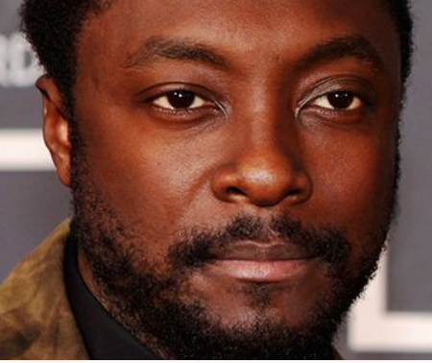


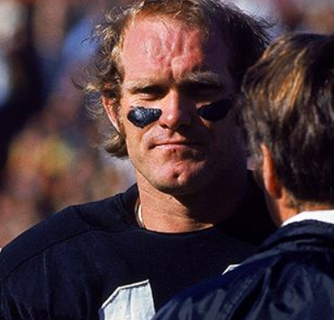
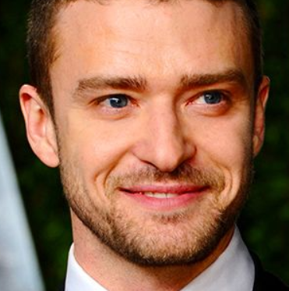
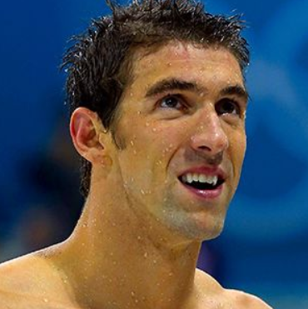
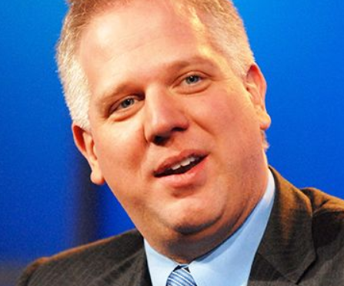

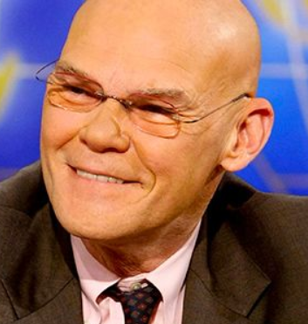

Some Famous ADHD faces…

Slide 26

What is the next step?
Get an assessment
Get diagnosed
Get treatment
Join a support group; meet other people with ADHD
Find out more information – internet, friends, books, attend seminars, conferences …
Learn from other people with ADHD
Find out new strategies and become aware of your old strategies and beliefs that didn’t serve you well …
Notes:
This might be a starting point in order to take the next step
Explain the metaphor with the arrows and the question mark. Different directions and choices and you need to find out more information before maing a decision.
From your own perspective where you are right now – what is the next step?
Picture source: http://www.vinayparmar.co.uk/personal/

Slide 27
Resources you can use
  ACO (ADHD Coaches Organization – www.adhdcoaches.org), the professional membership organization for ADHD coaches
  ADDA (Attention Deficit Disorder Association - www.add.org), an organization specifically for adults with ADHD
  ADHD Awareness Month (www.adhdawarenessmonth.org) which shares reliable information about ADHD
  CHADD (Children and Adults with ADHD – www.chadd.org), an organization for parents and adults with ADHD
  ADDitude Magazine (www.ADDitudemag.com) - a magazine for parents and adults living with ADHD

Slide 28

… you knew you could not fail?
What would you attempt to do if …
©ADHD Coaches Organization
Notes:
This is meant to be a challenge to think about when you leave today.
Picture source: microsoft clipart gallery online

Slide 29
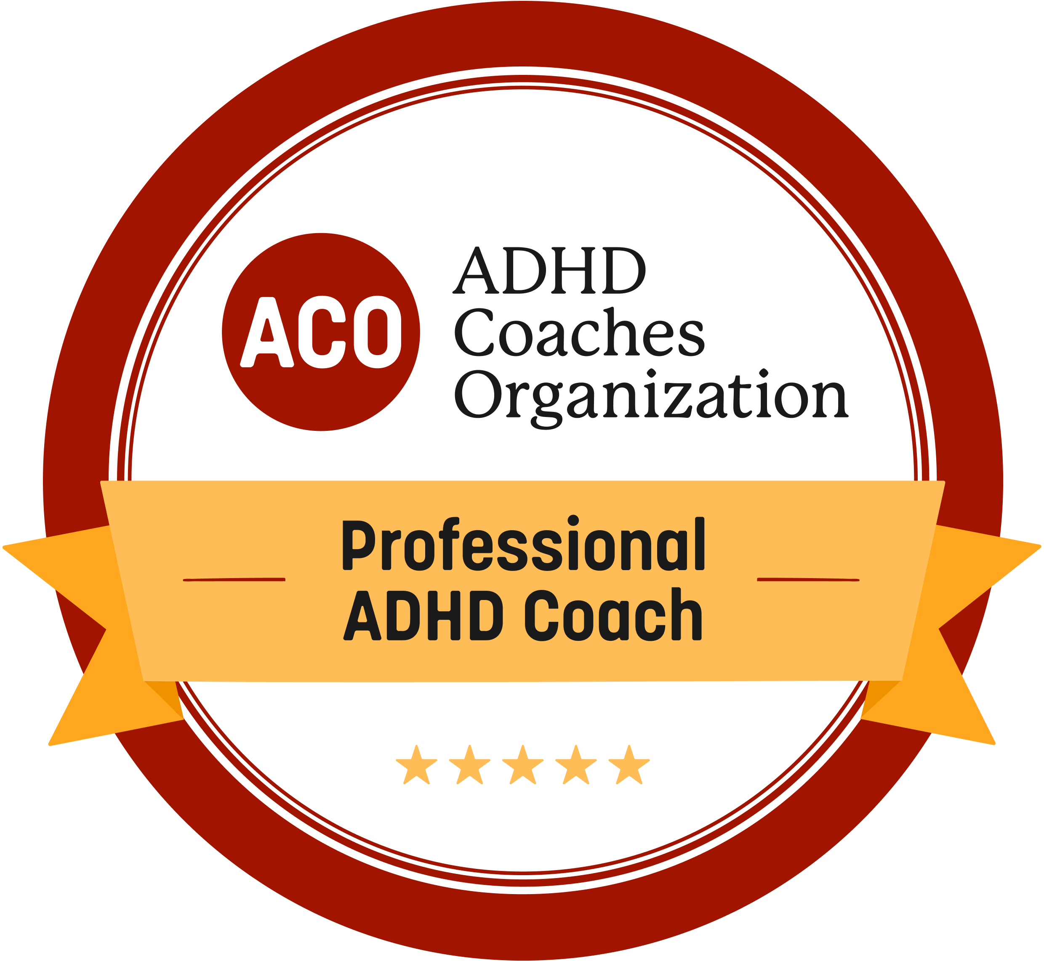
You can learn life skills and
ADHD management strategies through working with an ADHD Coach
To find an ADHD Coach visit
the ADHD Coaches Organization
www.adhdcoaches.org/find-your-coach/

Slide 30
Resources to learn more about ADHD
ACO (ADHD Coaches Organization) www.ADHDCoaches.org
ADDA (Attention Deficit Disorder Association) www.ADD.org
ADDitude Magazine www.ADDitudemag.com
ADHD Awareness Month www.ADHDAwarenessMonth.org
ADHD World Federation www.adhd-federation.org/
CDC (Centers for Disease Control and Prevention) www.CDC.gov
CHADD (Children & Adults with ADHD) www.CHADD.org
NAMI (National Alliance on Mental Illness) www.NAMI.org
NIMH (National Institute of Mental Health) www.NIMH.nih.gov
Psych Central www.PsychCentral.com
Understood https://www.understood.org/
Visit TED.com and search for ADHD videos www.TED.com

Slide 31

Thank you for your attention!
Notes:
Time for the Questions and Answer

Slide 32
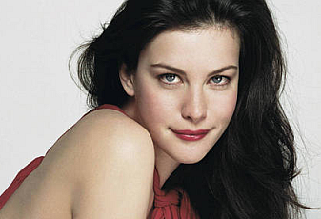



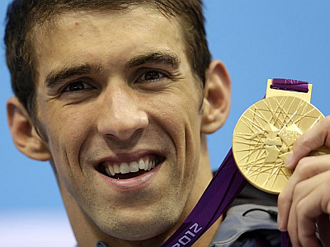





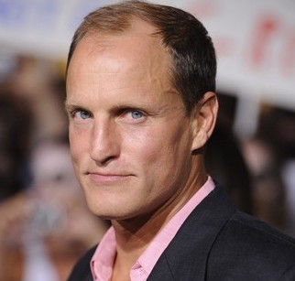



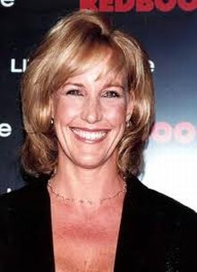
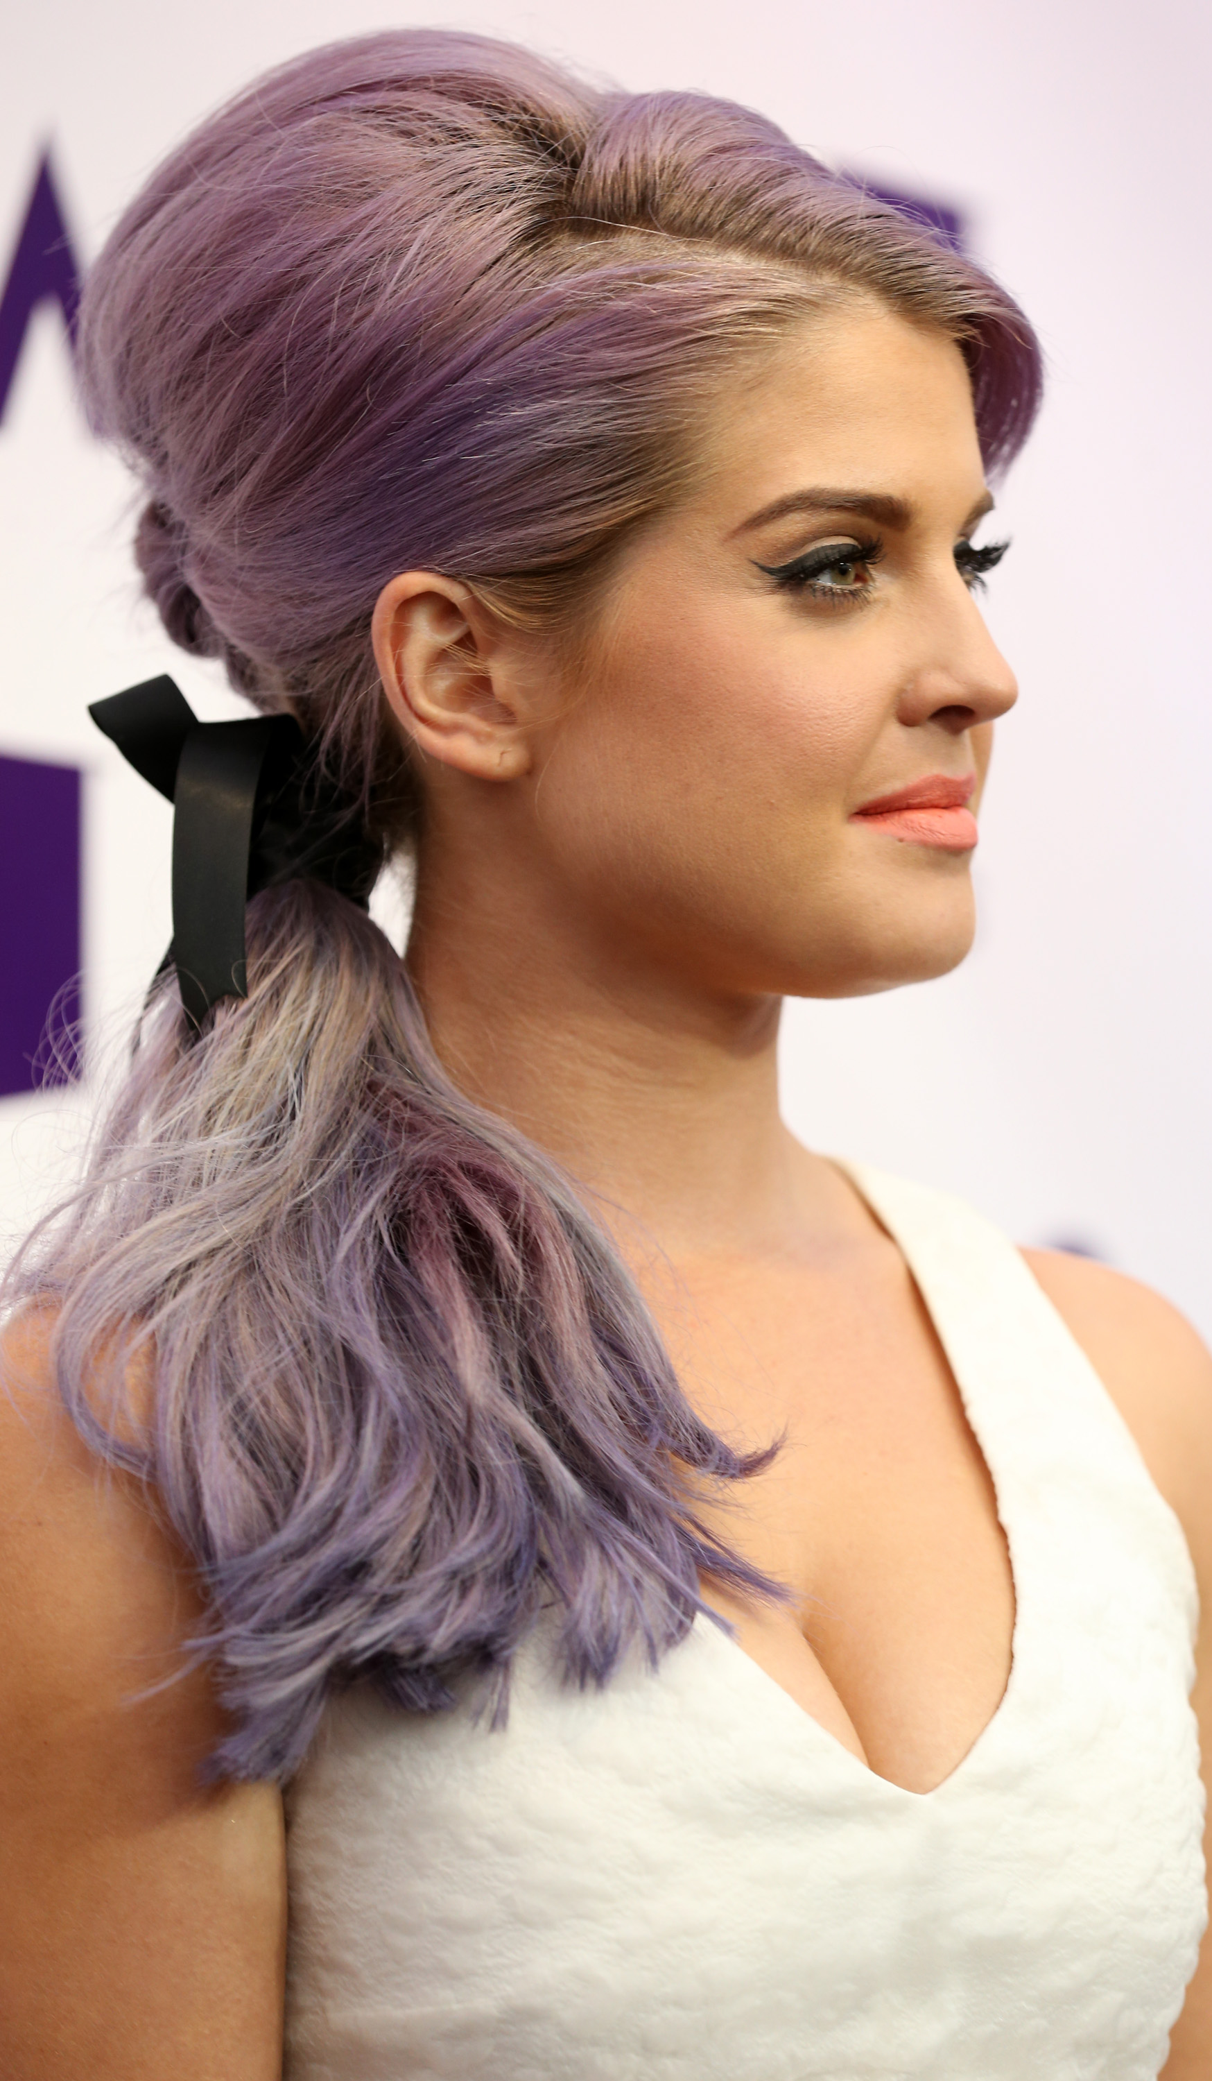
Being
Successful
Notes:
Liv Tyler, Actress, Model
Britney Spears, Singer
Howie Mandel, TV-Show “Howie Do It”
Will Smith, Actor, Producer
Michael Phelps, Swimmer, All Time Record Winner of 22 Olympic Medals (18 Gold Medals)
Magic Johnson, Basketball Player
Emma Watson, Actress (Harry Potter)
Will-I-Am, Singer Black Eyed Peas
Woody Harrelson, Actor
Jamie Oliver, British chef
Paris Hilton, Entrepreneur, Socialite, Heiress, and Reality TV-Starlet
Adam Levine, Singer in Maroon5
Erin Brockovich
Kelly Osbourne
Ty Pennington, American Carpenter, Actor, Model, TV-Show ”Extreme Home Makeover”
Sir Richard Branson, Virgin Founder, Entrepreneur, and Adventurer
Sources provided in a separate word document for this slide.

